Slide 1
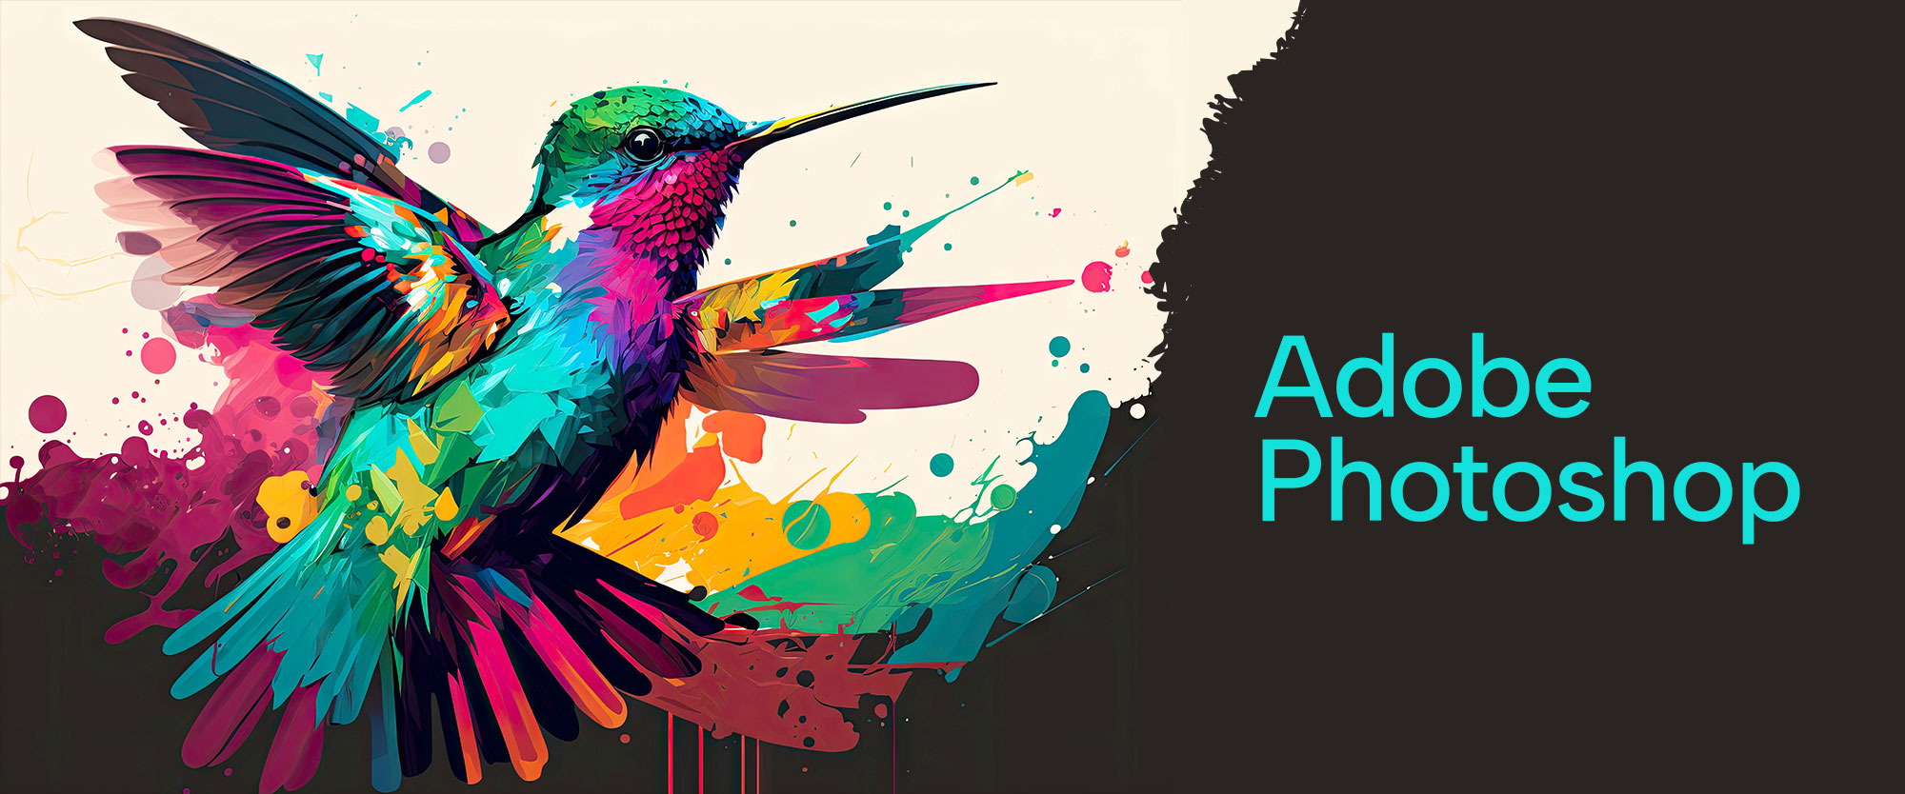

Slide 2
About today…
Text
Typography

Slide 3
What is Color Correction?
Definition of Typography
The art and technique of arranging type to make written language legible, readable, and visually appealing
Importance of Typography in Design
Typography plays a crucial role in design by creating a visual hierarchy, setting the tone of the document, and ensuring readability
Overview of Text Tools in Photoshop
Photoshop provides various tools for working with text, including the Horizontal Type Tool, Vertical Type Tool, and Type Mask Tools

Slide 4
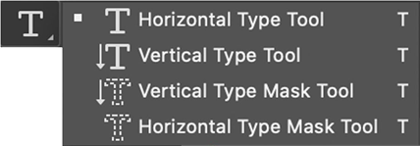
Text Tool Overview
Horizontal Type Tool
Allows you to create and edit horizontal text
Vertical Type Tool
Enables you to create and edit vertical text
Type Mask Tools
Create a selection in the shape of the text

Slide 5
Adding Text
How to Add Text
Select the Text Tool from the toolbar
Click on the canvas where you want to add text
Type your desired text
Editing Text
Highlight the text to change the font, size, color, etc.
Basic Text Formatting Options
Font
Choose from a wide range of fonts
Size
Adjust the text size
Color
Change the text color

Slide 6
Text Layers
Text as a Separate Layer
Select the Text Tool from the toolbar
Click on the canvas where you want to add text
Type your desired text
Advantages of Using Text Layers
Highlight the text to change the font, size, color, etc.
Managing Text Layers
Rename layers for better organization
Group text layers with related design elements

Slide 7
Formatting Text
Font Selection
Choose a font that suits the design's theme and purpose
Changing Font Size
Use the size dropdown in the Options bar or Character panel
Applying Bold, Italic, and Underline
Use the icons in the Character panel or Options bar
Changing Text Color
Click the color swatch in the Options bar to select a new color

Slide 8
Character and Paragraph Panels
Character Panel
Adjust font, size, kerning, tracking, and leading
Access additional text formatting options like all caps and small caps
Paragraph Panel
Align text left, center, right, or justify
Adjust indents and spacing between paragraphs

Slide 9
Text Effects and Styles
Adding Shadows, Glows, and Other Effects
Right-click on the text layer and select "Blending Options."
Apply effects like Drop Shadow, Outer Glow, and Bevel & Emboss
Using Layer Styles for Text
Layer styles can be reused and adjusted easily

Slide 10
Warping Text
Using the Warp Text Feature
Select the text layer
Click the "Create Warped Text" icon in the Options bar
Different Warp Styles
Explore styles like Arc, Bulge, and Flag
Customizing Warp Effects
Adjust the Bend, Horizontal Distortion, and Vertical Distortion sliders

Slide 11
Text on a Path
Drawing a Path
Use the Pen Tool or any shape tool to create a path
Drawing a Path
Select the Text Tool and click on the path to start typing along it
Adjusting Text Along the Path
Use the Direct Selection Tool to move and adjust the text

Slide 12
Advanced Text Effects
3D Text Effects
Use Photoshop's 3D tools to create text with depth and dimension
Combining Text with Images
Integrate text with images using clipping masks and layer blending modes
Using Blending Modes
Experiment with blending modes like Overlay, Multiply, and Screen for creative effects

Slide 13
Common Mistakes and Tips
Avoiding Common Typography Errors
Overuse of fonts
Poor contrast between text and background
Inconsistent spacing
Tips for Better Text Design
Stick to a limited number of fonts
Ensure high contrast for readability
Use alignment and spacing consistently

Slide 14
Practical Exercise
Create a Text-Based Design
Add a title using the Horizontal Type Tool
Apply a gradient overlay to the text
Create a shadow effect using Layer Styles

